Slide 1
Feature Extraction
Presented By-
Divyesh Mehta
Ashutosh Gajankush

Slide 2
Table of Contents
Overview of Feature Extraction.
HOG Algorithm.
Procedure to detect Human in an Image.
Code flow of Human detection.
Procedure to detect color in an Image.
Demonstration.

Slide 3
Feature Extraction
Feature extraction starts from an initial set of measured data i.e. training samples.
What if the input data is too large for the algorithm?
Reduction of input data to fit the algorithm is termed as Feature Extraction.
Feature extraction is a procedure to be followed to extract important information from the input data.

Slide 4
Histogram of oriented gradients
The histogram of oriented gradients (HOG) is a feature descriptor used in computer vision and image processing for the purpose of object detection.
This method is similar to that of edge orientation histograms, scale-invariant feature transform descriptors, and shape contexts, but differs in that it is computed on a dense grid of uniformly spaced cells and uses overlapping local contrast normalization for improved accuracy.

Slide 5
Detailed Explanation of Histogram
Image Gradient are simply intensity changes across pixels in an image (or a small patch of it).
Given a pixel arrangement, you can find out how much the intensity values change (from lighter tones to darker shades, or the converse) along any direction.
You can do that for different directions, and compute a histogram. The bins of the histogram would be the different directions you picked, and the value of each bin corresponds to the number (actually the magnitude) of intensity changes you noted in that direction.
So it essentially represents a distribution of intensity fluctuations along different orientations (directions).

Slide 6
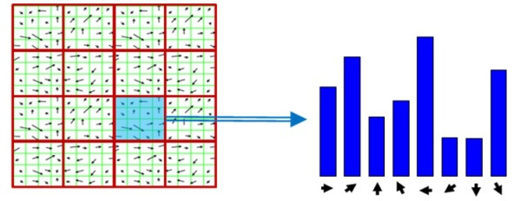

Slide 7
Explanation of HOG
Divide the image into small connected regions called cells, and for each cell compute a histogram of gradient directions or edge orientations for the pixels within the cell.
Discretize each cell into angular bins according to the gradient orientation.
Each cell's pixel contributes weighted gradient to its corresponding angular bin.
Groups of adjacent cells are considered as spatial regions called blocks. The grouping of cells into a block is the basis for grouping and normalization of histograms.
Normalized group of histograms represents the block histogram. The set of these block histograms represents the descriptor.

Slide 8
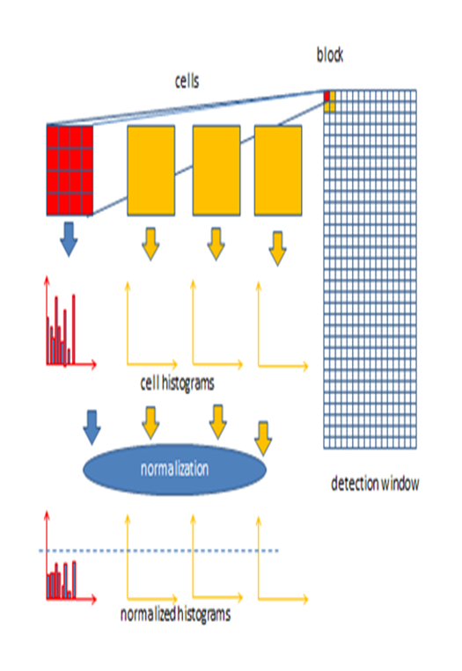
Block Diagram of HOG

Slide 9
Procedure of Human detection
Extracting HOG descriptors from X positive samples.
Extracting HOG descriptors from Y negative samples.
Training Support Vector Machine on this positive and negative samples.
On test image sliding window technique is used.
The above step will detect many such windows.
Next step will be combining all the results to find a pedestrian in an image.

Slide 10
Code Flow
Initializing HOG descriptor.
Taking the Input Image.
Resizing every image into one size.
Detecting people in the image by calling ‘detectMultiScale’ method in HOG.
Drawing the bounded boxes.
Applying non-maxima suppression to the bounded boxes.
Drawing the final bounded boxes.
Displaying the original and Pedestrian Detected image.

Slide 11
Procedure and flow of Color detection
Set the lower and upper boundary of the color you wanted to detect.
Resize the image for faster processing.
Blur the image to remove unwanted noise.
Convert the image to the HSV (Hue, Saturation, Value) color space.
Construct a mask using (inRange) function of OpenCV using the lower and upper bound of a particular color.

Slide 12
Continued flow
Using erode and dilate functions of OpenCV to remove unwanted blobs left in the mask.
Find the contours in the mask.
Detect a centroid of the contour.
Using the contour and the centroid draw a smallest possible circle around them.

Slide 13
Drawbacks
Various style of clothing in appearance.
Different possible articulations and Postures.
Proximity of pedestrians.

Slide 14
THANK YOU
SIT BACK AND ENJOY DEMONSTRATION

